Slide 1
ROCK PAPER SCISSORS A game of chance
Presented by :-
Aditya Raj(1916718)

Slide 2
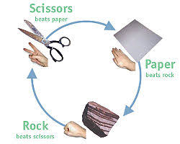
INTRODUCTION
Comes from a Japanese game called “jan-ken”
It’s a game usually played by two people, where players make one of three shapes with their hands at the same time. The “rock” beats scissors, the “scissors” beat paper and the “paper” beats rock; if both players throw the same shape, the game is tied.

Slide 3
RULES
Paper smother rock
Rock breaks scissors
Scissors cut paper
If each player throws the same sign then it is a tie and will be replayed

Slide 4
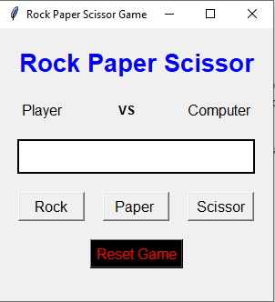
OBJECTIVE
To complete a Rock Paper Scissors using “Pycharm” that allows a person to play against the computer.
The game has been started on the compsci-drive in the Designing Tech folder.

Slide 5
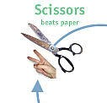

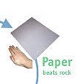
HOW TO THROW SIGNS
Scissors
ROCK
PAPER
To throw rock just make a closed fist.
To throw paper just make another open hand with the palm down.
To throw scissors just place your index finger and middle out while keeping all other fingers in. Just like a piece sign.

Slide 6
HOW WILL YOU DECIDE THE WINNER ??
Algorithm 1
Algorithm 2
If player 1 chooses scissor and computer chooses scissor it’s a tie…
If player 1 chooses scissor and computer chooses paper, player 1 wins because scissors cut the paper…
If player 1 chooses rock and computer chooses scissor then computer wins because rock smashes the scissor…
If player 1 chooses rock…
If computer chooses rock it’s a tie…
If computer chooses scissors ,then player 1 wins because rock smashes scissors…
If computer chooses paper then computer wins because paper covers rock…

Slide 7
FINISH THE PROGRAM
Complete the code.
It’s in the computer sprite script.
Fix the part after when I receive determine winner
Make it say who wins and why
Notes:
c

Slide 8
CONCLUSION
The end strategy of a simple Rock Paper Scissors game is to be random and fast. Statistically ,each attack will tend to occur just as frequently as another, given that each is equally effective.
So, this was an easy and fun way to create a rock paper scissors game. It is customizable, as per a developer’s personal preference. Not just rock paper scissors, but many more games can be developed easily in Python using various tools and libraries available.

Slide 9
THANK YOU !!

